Slide 1
Security Presentation MOH Consolidated Data Repository (MCDR)
XX Nov 2019

Slide 2

Introduction
<To fill in the names of the rest of the attendees…>
Darren Yeo
Security Lead Consultant
Tumulak Sharon Desuyo PM, Advanced Analytics & Big Data
Luo Dong Hua Solution Architect
Kristie Wee
Account Director
Edwin Ang
Practice Lead, Identity & KMS
Quek Seow Hiah
Solution Manager
Jason Lu Pre-Sales Consultant, Security

Slide 3
Agenda
Overview of MOH Consolidated Data Repository (MCDR)
Trustwave Security Services and Threat Risk Assessment
Q&A

Slide 4
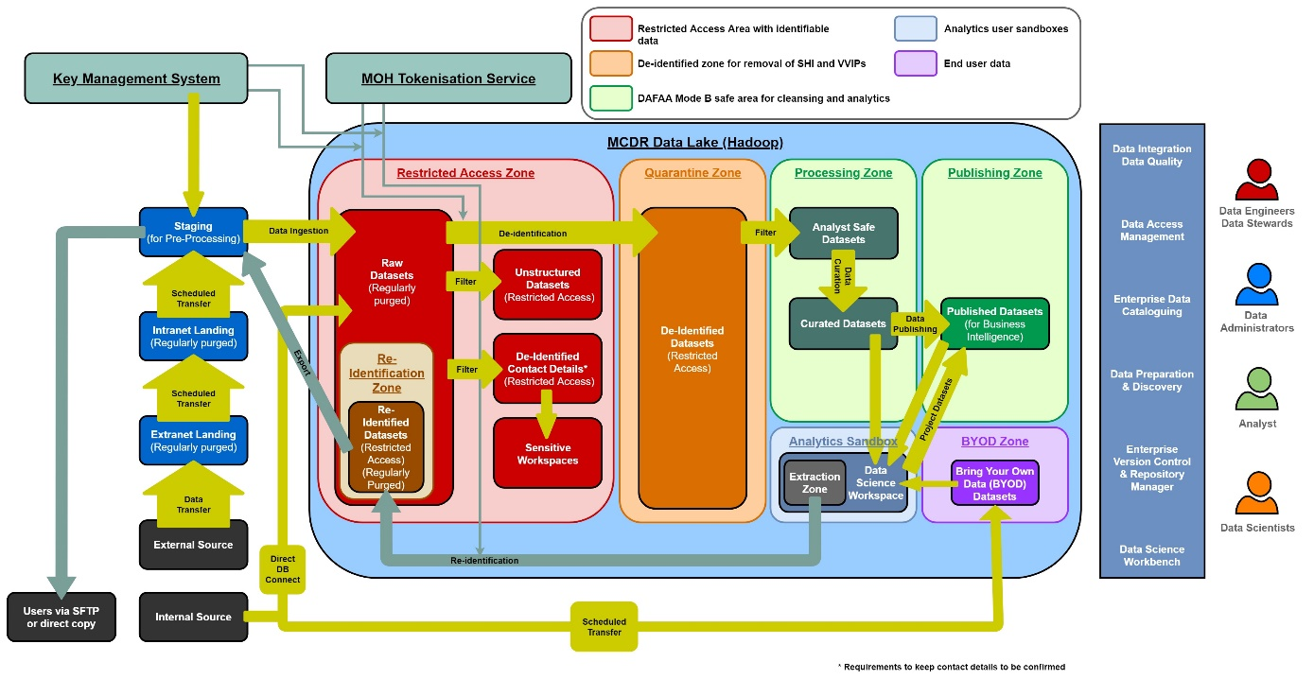
Solution Requirements of MOH MCDR
Process Flow in MOH MCDR

Slide 5
Summary of Solution Components
NCS has proposed the Best-of-Breed solution to meet MOH requirements
S/No | Solution Component | Proposed Solution
1 | Big Data Platform (with Unified Access Control) | Hortonworks Data Platform
2 | Data Management | Informatica Big Data Management Informatica Big Data Quality
3 | Metadata Management | Informatica Enterprise Information Catalog
4 | Big Data Discovery and Data Preparation | Informatica Enterprise Data Preparation
5 | Data Science Workbench | Cloudera Data Science Workbench
6 | Version Control | GitHub
7 | Repository Management | Nexus Repository
8 | Key Management System | Thales Vormetric Data Security Manager (DSM) Thales Vormetric Application Encryption (VAE) Thales Vormetric Key Management (VKM)
9 | Tokenisation | Thales Vormetric Tokenization Server (VTS)
10 | Virtualisation Solution | Citrix
11 | Antivirus Software | Trend Micro Deep Security (provided by MOH)

Slide 6
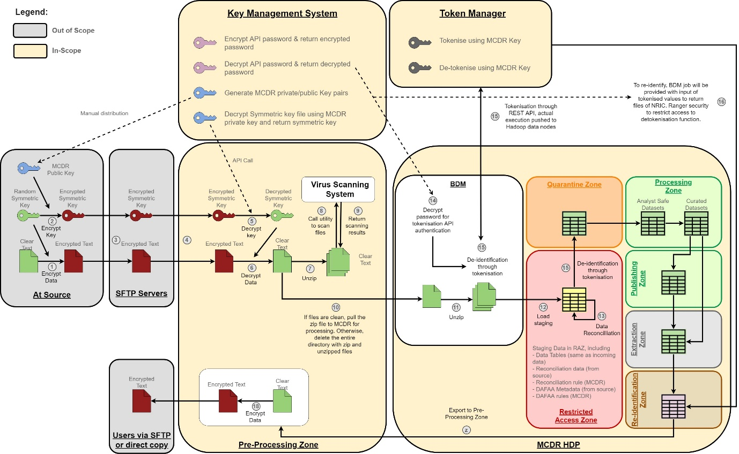
Loading Strategy in MOH MCDR – File-based Processing

Slide 7
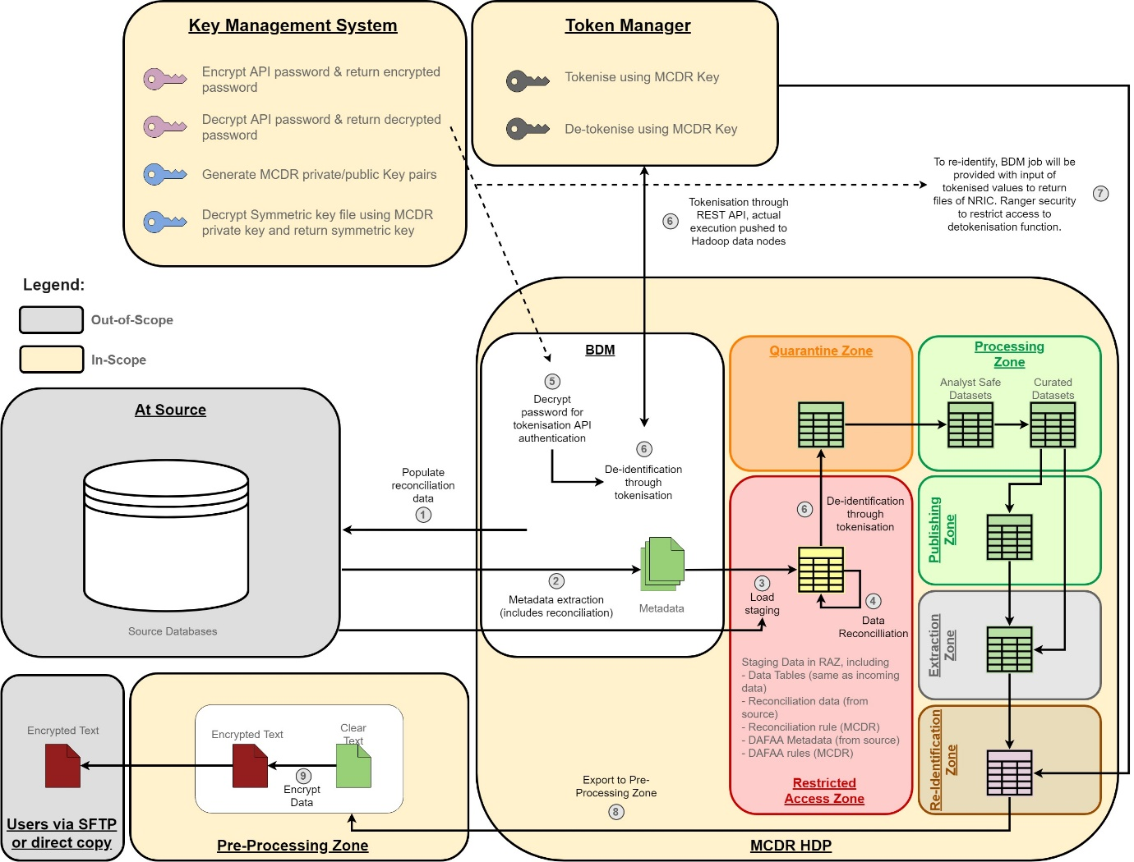
Loading Strategy in MOH MCDR – Database Processing

Slide 8
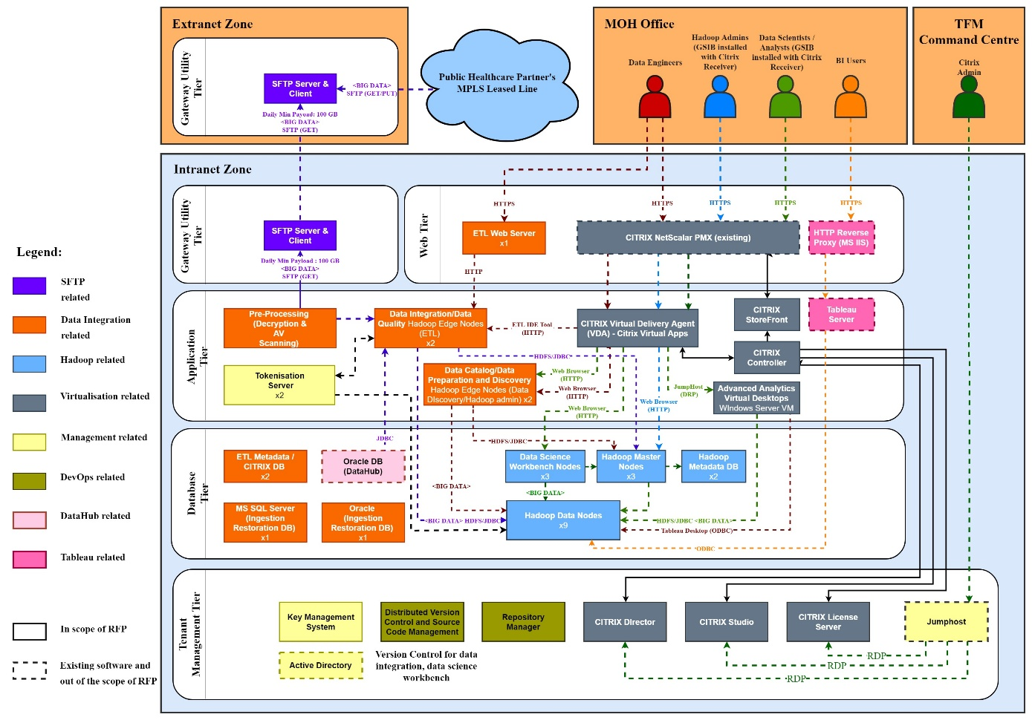
Key Architecture Recommendations - PROD
Notes:
Use Redhat Active/Passive Clustering instead of MySQL Master/Slave Replication for Cloudera Repo
Use separate VM for MySQL repo instead of co-location

Slide 9
Security Measures on MOH MCDR
Security Assurances
Security Risk & Threat Assessment
Network VA, Web VAPT
Policy Compliance Review
IT Security Governance Service
Vulnerabilities Scan – Java codes
Network Defense
IDS/IPS is provided by GCI Central firewall
Network Security Zones (web. App, DB & Mgmt)
System Compliance
System Hardening
Hardening Compliance Check
Network VA
Authentication and Identity Management
Leverage MOH Active Directory
Unified Access Control for Ranger
Encryption
Hadoop Data-at-rest (TDE) and data-in-motion (TLS) encryption with Ranger KMS
Thales Tokenisation
Malware Protection
Trend Micro Deep Security Anti-Virus for Windows & Linux
Others
Logs from MCDR will be routed into MOH SIEM
Virus scan on open source packages before they are updated into the repository
Hadoop Security Log Analysis (Value-Added Service)
NCS has proposed AA model development for Anomalous activity detection using ranger logs

Slide 10
IT Security Governance Service
Implementation Phase
Operation Phase
IT Security Management Plan, Security Risk Management Process, Standard and Procedure IT Security Governance Framework development
Pre-commission Security Assessment Management
Review Hardening framework for Citrix & Hadoop etc.
Review & Recommend to System Security Acceptance Test Plan
Consultancy of the Cyber Security design to the implementation
Working with Third Party Assessor
Security Awareness Briefing
Security patch monitoring & tracking
Follow up of CWC (Cyber Watch Centre) and/or GITSIR
Security Audit Log Review for system & DB ( leverage on MOH central logger)
Privilege Account Review for NCS support team accounts
Security Meeting & Reporting
Quarterly VA Scan
Security Audit Liaison
IT security Awareness Briefing
IT Security Incident Support

Slide 11
Agenda
Overview of MOH Consolidated Data Repository (MCDR)
Trustwave Security Services and Threat Risk Assessment
Q&A

Slide 12

About Trustwave
Microsoft Top Threat Indicator Contributor Award – 2019
First CREST Global Member
Certified professionals : CPSA, CRT, CCT App, CCT Infra, CSAS, CSAM
CREST approved training provider
Train Govtech agencies on IRM (Incident Response Management) and VA (Vulnerability Assessment)

Slide 13

Next-Gen Managed Security Services
Threat Detection & Response
MOH Scope
Threat & Vulnerability
Management
Security Testing
Risk Assessment (including Threat Risk Assessment)
Policy Compliance Review
Host Configuration Review
Network VAPT
App VAPT
Proactive Threat Hunting
Security
Advisory

Slide 14
Risk Assessment Scope
Objectives:
Identify known security risks that MOH CDR system may be exposed to
Evaluate the extent of the risks and adequacy of existing controls to protect system’s information assets
Provide recommendations to bridge security gaps and strengthen the system’s security posture
Ascertain management’s treatment of the risks
Review period:
Pre-commission
Methodology:
GovTech Risk Management Methodology or NIST Risk Assessment Methodology (800-30)

Slide 15
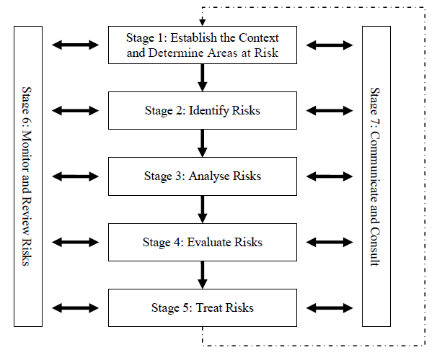
GovTech ICT Risk Management Methodology

Slide 16
NIST Risk Assessment Methodology (800-30)
Step 1
Prepare for Risk Assessment
Step 2
Conduct Risk Assessment
Identify threat sources
Identify vulnerabilities
Determine likelihood of occurrence
Determine magnitude of impact
Determine risk

Slide 17
Risk Assessment Approach
Information review:
System assets, project documentations
Security policies, standards and procedures
Changes made to the system within the review period – service requests, change requests (NA)
Security incident reports, security testing reports, and applicable audit reports within the review period (NA)
Discussions with stakeholders:
NCS project team
MOH FM
References:
Cyber security industry standards
e.g. ISO27002, NIST 800-53, CIS Critical Controls
Recent cyber threat reports and security advisories
Exclusions:
Medinet subscribed infrastructure (e.g. data centre, network)
Architecture design review, technical test (e.g. vulnerability assessment, penetration testing, source code review)
Deliverable:
Risk Assessment report comprising risk register

Slide 18
Threat Risk Assessment
Objectives
Identify threats and compliance requirements, and evaluate their risk
Balance risks, controls, and usability
Reduce threats from the start
Spoofing
S
I
Information Disclosure
Authentication
Confidentiality
Tampering
T
D
Denial of Service
STRIDE
Integrity
Availability
Repudiation
R
E
Elevation of Privilege
Non-repudiability
Authorization

Slide 19
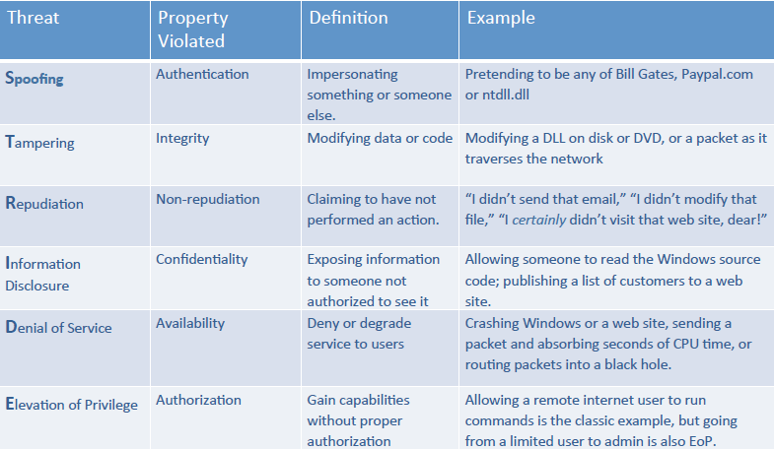
STRIDE

Slide 20
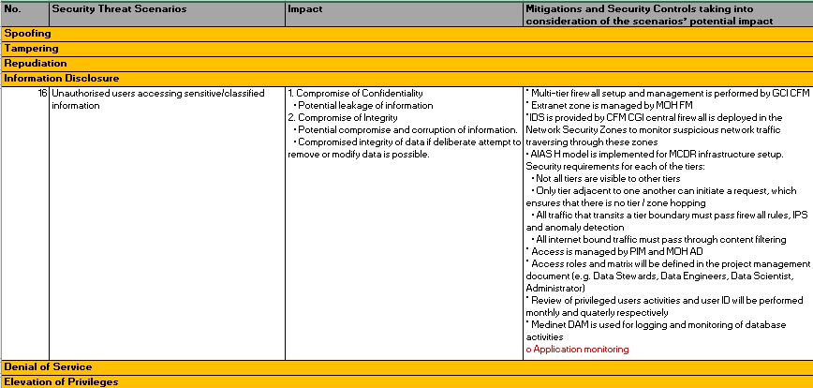
STRIDE Methodology
First, the security threat scenarios are determined in the 1st column
The 2nd column (Impact) is evaluated and determine which of the C, I, A areas are affected
The mitigations in the 3rd column (mitigations and security controls) is documented to address the threat in the 1st column (Security Threat Scenarios
Identified gaps and recommendations if any will be documented in the 3rd column

Slide 21
Spoofing & Tampering
Spoofing
Network intrusion via network parameter entry points (i.e. MOH CDR Intranet)
Uncontrolled network roaming within MOH CDR local area network
Unauthorised access to backend databases via front-end systems, external networks or within internal network (e.g. SQL injection attacks, remote network access, etc.)
Exploitation of default accounts and passwords
Eavesdropping / data theft at various points when data is in transit
Tampering
Unauthorised changes carried out on production systems
Tampering of audit logs during transit and at rest
Inaccurate system timings on audit logs
Data being tampered / exfiltrated via interception of data at various points when data is in transit
Deliberate tampering of data at rest
Unauthorised changes to program source codes
Exploitation of system services due to weak system security

Slide 22
Repudiation & Information Disclosure
Repudiation
Undetected user/system events due to lack of audit logging of security events
Ineffective handling and resolution of security incidents
Information Disclosure
Unauthorised remote access to administer/ operate MCDR systems
Unauthorised users accessing sensitive/classified information
Attack on weak encryption

Slide 23
Denial of Service & Elevation of Privileges
Denial of Service
Incapacitation of data channel through denial of service attacks
Servers infected by malware, virus or worms
Web server intrusion/denial of service due to inadequate application security protection
Hackers attack IT systems through system vulnerabilities
Elevation of Privileges
Abuse and/or misuse of valid user accounts which are granted permission to view sensitive information
Exploitation of application / service accounts

Slide 24
Spoofing (STRIDE) - Sample
Security Threat Scenarios
Network intrusion into MOH via network parameter entry points
Impact
1. Compromise of Confidentiality
Potential leakage of information
2. Compromise of Integrity
Potential compromise and corruption of information
3. Compromise of Availability
Potential compromise and loss of information
Mitigations and Security Controls taking into consideration of the scenarios’ potential impact
MCDR system is an intranet system and is not accessible via internet
Network Intrusion Prevention System (NIPS) is placed at perimeter of GCI network to monitor incoming network threats to GCI network (managed by GCI Central Firewall team)
Multi-tier firewall setup and management is performed by GCI CFM
Extranet zone is managed by MOH FM
VAPT test will be conducted before system goes live
Note:
Medinet is only a tenant in the GCI network

Slide 25
Elevation of Privileges (STRIDE) - Sample
Security Threat Scenarios
Abuse and/or misuse of valid user accounts which are granted permission to view sensitive information
Impact
1. Compromise of Confidentiality
Potential leakage of information
Mitigations and Security Controls taking into consideration of the scenarios’ potential impact
Access roles and matrix will be defined in the project management (e.g. Data Stewards, Data Engineers, Data Scientist, Administrator)
Administrators will be trained by NCS to perform FM role
Active Directory is used to manage user access
MCDR servers can only be accessed directly from the Data Centre management console
Medinet DAM is used for logging and monitoring of database activities
Audit logging are enabled on all MCDR system (OS, database and application level) to capture user and system activities
Administrative user accounts activities will be reviewed periodically

Slide 26
Denial of Service (STRIDE) - Sample
Security Threat Scenarios
Servers infected by malware, virus or worms
Impact
1. Compromise of Confidentiality
Potential leakage of information
2. Compromise of Integrity
Potential compromise and corruption of information
Compromised integrity of data if deliberate attempt to remove or modify data is possible.
3. Compromise of Availability
Potential compromise and loss of information
Denial of service from loss of or modified data
Users are unable to access the required data in a timely manner
Mitigations and Security Controls taking into consideration of the scenarios’ potential impact
Windows and Linux (RHEL) servers are hardened during implementation
Multi-tier firewall setup and management is performed by GCI CFM
TrendMicro Antivirus is installed on MCDR servers to prevent malware intrusion and infection
MOH FM will manage antivirus installation and log review
Logs will be forwarded to MOH SIEM for centralized log management and monitoring by MOH FM
Only WOG workstations and laptops is used to access MCDR
Servers and WOG USB ports are locked down
Note:
MOH to provide EDR for implementation

Slide 27
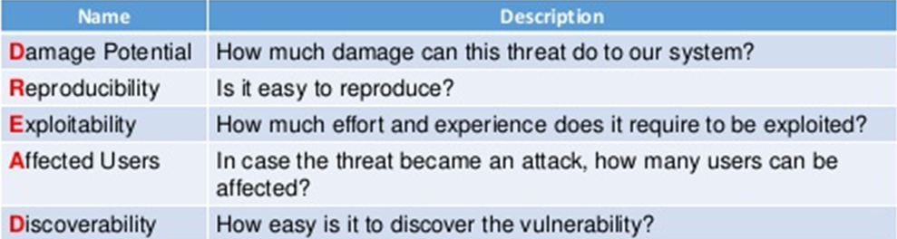
DREAD

Slide 28
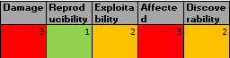
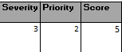
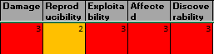
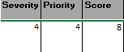
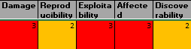
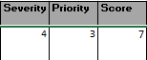
DREAD on STRIDE Threats - Sample
Security Threat Scenarios
1) Network intrusion into MOH via network parameter entry points (Threat No. 1 - Spoofing)
2) Abuse and/or misuse of valid user accounts which are granted permission to view sensitive information (Threat No. 22 – Elevation of Privileges)
3) Servers infected by malware, virus or worms
(Threat No. 19 – Denial of Service)

Slide 29
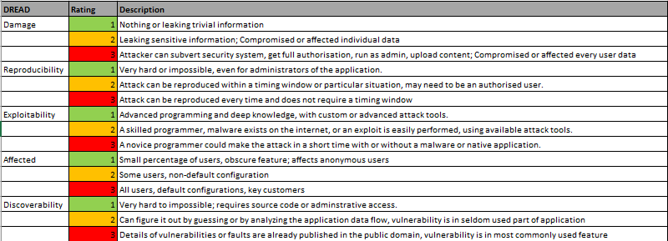
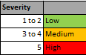
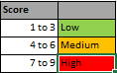
DREAD Methodology
Severity takes precedence with a higher rating than Priority
The final DREAD rating will be the sum of the (Severity & Priority) ratings
The higher the DREAD rating, the more serious the threat is
Prioritise threats according to their DREAD rating

Slide 30
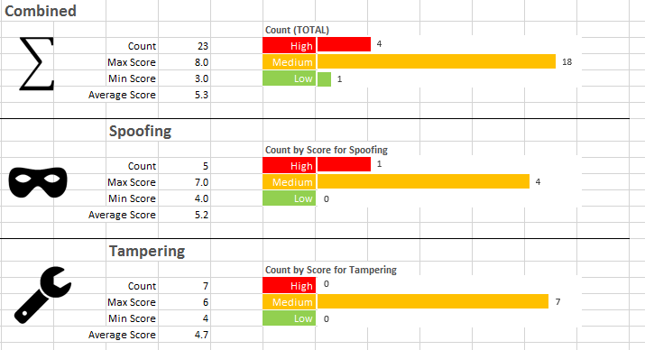
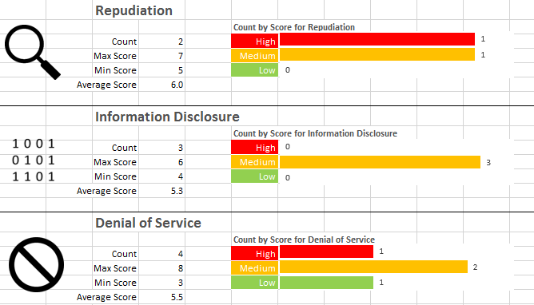
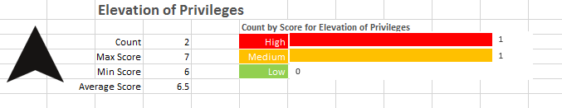
DREAD on STRIDE Report

Slide 31
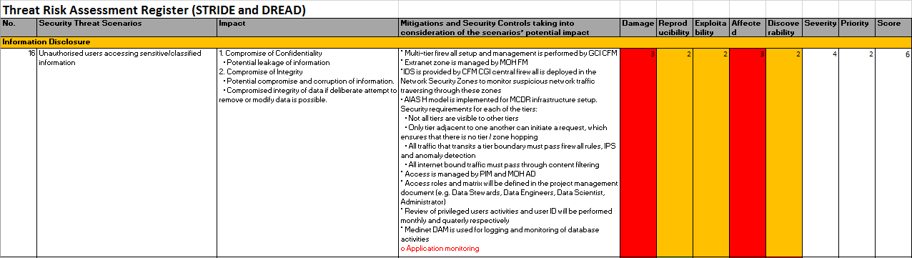
TRA Risk Register

Slide 32
Q&A
Any questions?

